Slide 1
Practical_Implementation_Of
Machine_Learning
Koushik Varma Mandapati

Slide 2
How did we get here???
WEEK 1 – Simple Linear Regression and Logistic Regression
WEEK 2 – Classification and Clustering
WEEK 3 – Artificial Neural Networks
WEEK 4 – Convolutional Neural Network

Slide 3
What’s this ppt about???
Our final project is to take a dataset and code an algorithm from scratch.
We chose the dataset containing all the conditions that may cause Autism.

Slide 4
Stuff i learnt while doing this project
I learnt how to use some important modules in python such as pandas, pyplot, numpy.

Slide 5
How K_Means works
Calculating distances from point to nearest centroid, and adding point as cluster to the nearest centroid
04
Repeat until max iterations are reached or till we have a pretty good accuracy
01
03
Finding the average of all points of a cluster and getting new centroid location
Calculating the accuracy and iterating another time depending on it.
02

Slide 6
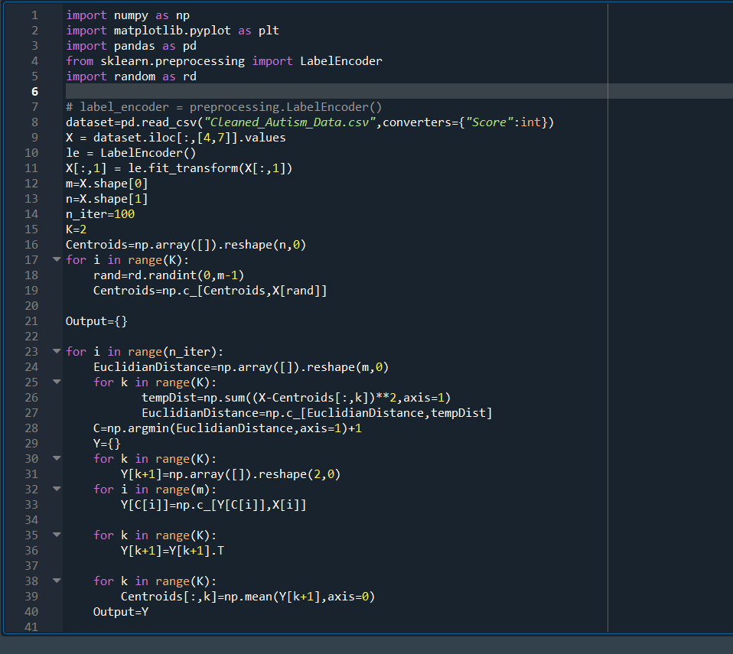
Few Screenshots
Just so i have more slides to show

Slide 7
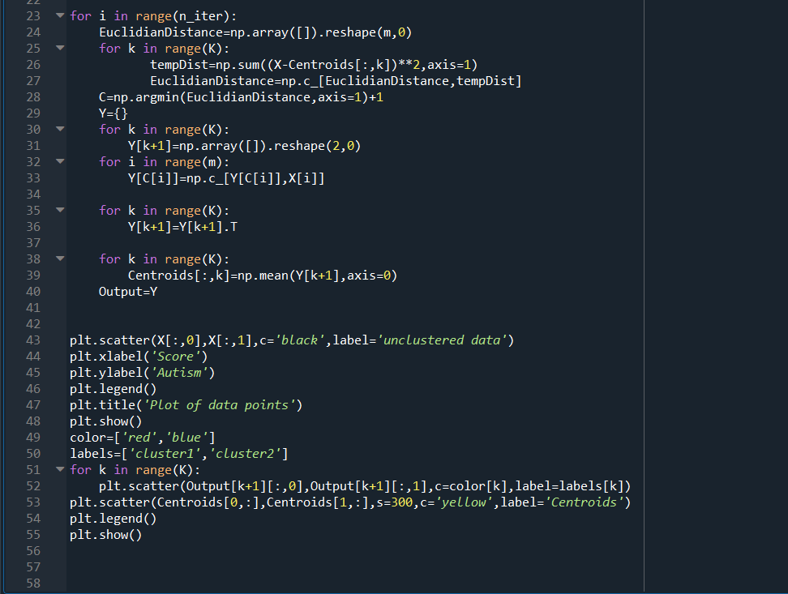

Slide 8
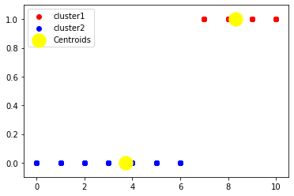
Output-Visualization of how the cluster looks like

Slide 9
Thank you!

